Slide 1
PAC Learning in Machine Learning

Slide 2
What is PAC Learning?
• PAC = Probably Approximately Correct
• A learning framework that ensures:
– Hypothesis is approximately correct (low error rate)
– With probably(high confidence)

Slide 3
"Probably": This part of PAC learning indicates a high level of confidence. It means that the learner's hypothesis will be correct with a high probability.
"Approximately Correct": This part implies that the hypothesis is not necessarily perfectly accurate but is close enough to be practically useful.

Slide 4
PAC Theory
• ε (epsilon): Allowed error margin
• δ (delta): Confidence parameter
• H: Hypothesis class
• m: Number of training samples
Hypothesis
h = the final learned model(rule)
H = all possible models the algorithm could choose

Slide 5
Sample Complexity Formula
To guarantee PAC learning:
m ≥ (1/ε) * ( ln(|H|) + ln(1/δ) )
Where:
• m = required training samples
• |H| = size of hypothesis space
L(h)≤ϵ

Slide 6
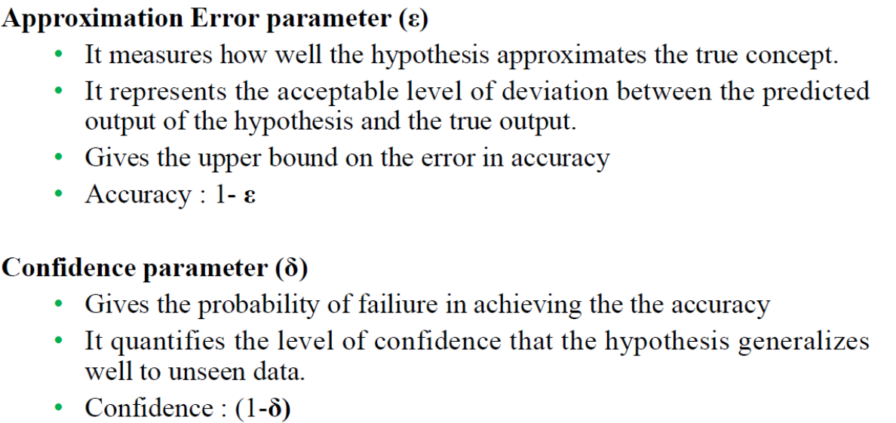


Slide 7
Sample Complexity Example
• ε = 0.1 (10% error allowed)
• δ = 0.05 (95% confidence)
• |H| = 100 hypotheses
m=???
m ≥ (1/0.1) * ( ln(100) + ln(1/0.05) )
= 10 * (4.6 + 3)
= 76 samples needed

Slide 8
Example: Email Spam Classification
Goal: Classify email as Spam / Not Spam
Choose PAC parameters:
ε,δ
Data features:
Suspicious words, links, attachments, sender type

Slide 9
Learned Hypothesis
Example:
If model error ≤ 5% on samples:
• PAC guarantees ≤ 5%

Slide 10
Summary
• PAC = Probably Approximately Correct guarantees accuracy using finite samples
• Uses parameters ε (error) and δ (confidence)
• Sample complexity gives number of samples needed

